Slide 1

5W Sentence Stretching Method with Examples

Slide 2
Which sentence do you think gives a better example of a hungry dog?
The dog was hungry.
The dog howled in hunger.
The stray dog howled mournfully in the alley at midnight because of its hunger.
Notes:
🍐 This is a Pear Deck Draggable™ Slide.
🍐 To edit the type of question, go back to the "Ask Students a Question" in the Pear Deck sidebar.

Slide 3


Slide 4
Illustration Transitions
Stretched
(5W) Sentences
Awesome Examples

Slide 5



Slide 6
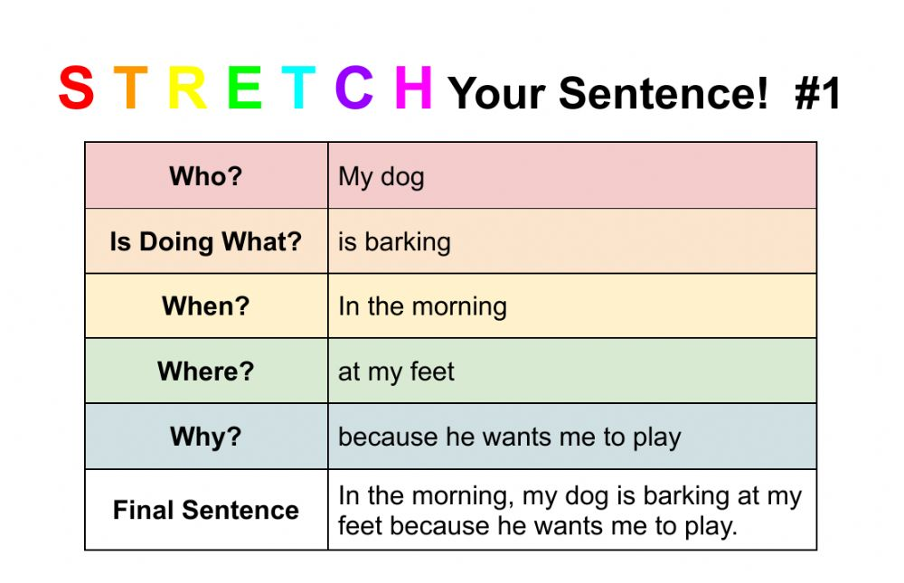

Slide 7
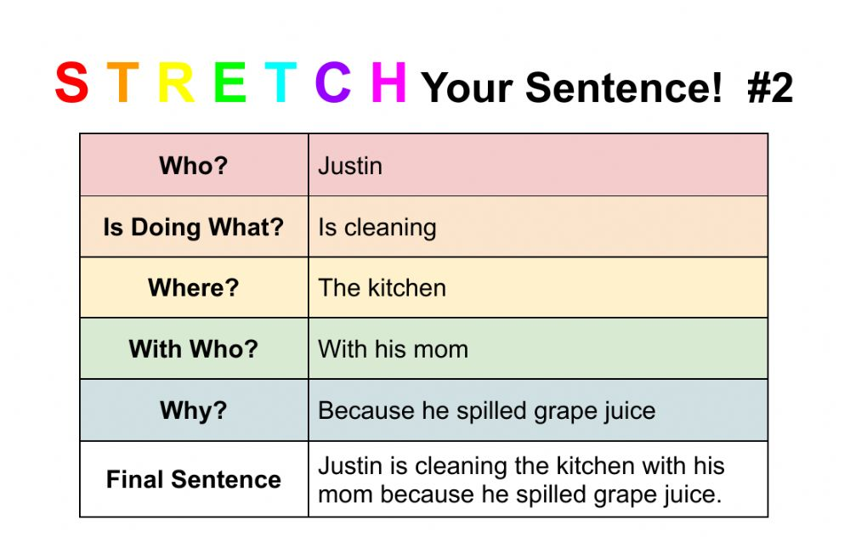

Slide 8
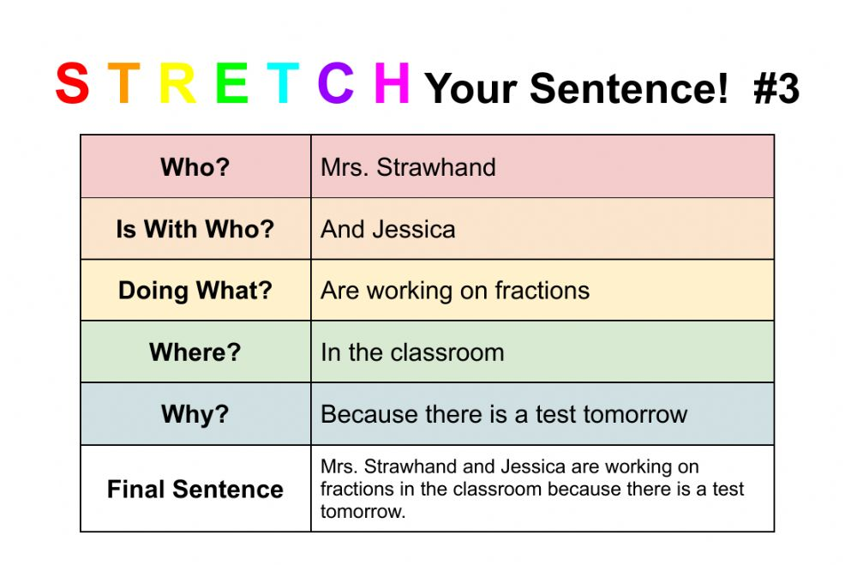

Slide 9
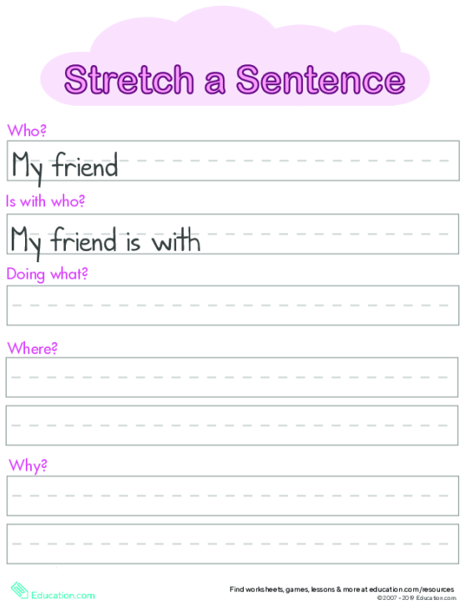
Example
My friend is with his dog playing fetch at the park because they both want to have fun and exercise.
Notes:
🍐 This is a Pear Deck Text Slide
🍐 To edit the type of question, go back to the "Ask Students a Question" in the Pear Deck sidebar.

